Slide 1

Converging Approaches in
Software Switches
Combining code- and data-driven approaches
to achieve a better result
Ben Pfaff
blp@ovn.org
August 4, 2016

Slide 2
Agenda
1 | The Point
2 | Definitions and Distractions
3 | Code-Driven Switches
4 | Data-Driven Switches
5 | Code-Driven → Data-Driven
6 | Data-Driven → Code-Driven

Slide 3
The Point
There are two main ways to build software switches:
"code-driven"
and
"data-driven"
Usually, these are considered to be alternatives.
They can actually be complementary.

Slide 4
What's a Software Switch?
A software switch forwards Ethernet packets among physical or virtual ports.
Necessary for VMs to share physical Ethernet ports.
An old idea.
Many exist today, including the following developed at VMware (and many others):
  vSphere Distributed Switch (VDS)
  NSX Edge Switch
  Open vSwitch
Software Switch
VM2
VM1
eth0

Slide 5
Distractions
These choices affect implementation and performance, but they are not related to the architectural distinction I'm talking about.
Kernel vs. Userspace
  All-kernel
  All-userspace
  Mix
Packet I/O method
  Custom kernel module
  AF_PACKET sockets
  DPDK (kernel or userspace)
  Netmap
It's unfair to compare software switches against packet I/O methods, but advocates of packet I/O methods often do it.

Slide 6
Code-Driven Switch Pipeline
Executes series of code fragments ("stages") per packet.
code
code
code
code
ingress
egress
code
Obvious
Loose coupling

Slide 7
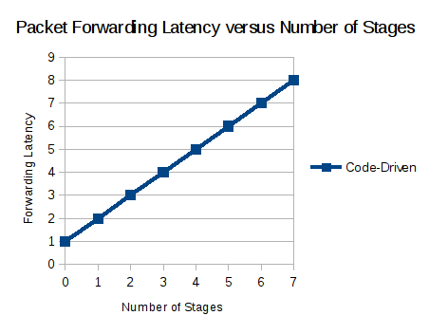
Code-Driven Pipeline Stages
code
Can do anything or nothing
Each stage increases per-packet latency
Near-zero fixed overhead
Therefore: null pipeline is very fast.

Slide 8
Some Code-Driven Switches
Linux bridge + iptables + ebtables + …
Click
VSphere Distributed Switch (VDS)
NSX Edge Switch
VPP
BESS

Slide 9
This super-dramatic slide was in the corporate slide template and I felt I had to use it somewhere.

Slide 10
Data-Driven Switch Pipeline
A single engine drives each packet through all the stages,
each of which is a data table.
data
parser
data
data
data
ingress
egress
data
- Unnatural for programmers
- Limited by engine's capabilities
- Parsing is expensive
+ Parsing only happens once per pipeline.

Slide 11
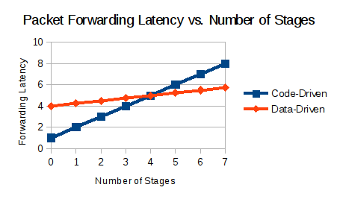
Data-Driven Pipeline Stages
N stages can be cross-producted into 1 stage (see NSDI 2015 paper):
data
data
data
data
data
×
×∙∙∙×
×
=
N stages
High fixed cost.
Adding stages adds little per-packet latency.
Therefore: null pipeline is slow, complex pipeline is fast.
Hardware classification offload is possible.

Slide 12
Some Data-Driven Switches
Open vSwitch
MidoNet

Slide 13
Code-Driven ↔ Data-Driven Crossover
Can we combine the strengths of both approaches?
Code-Driven:
+Low fixed overhead
+Flexibility.
Data-Driven:
+Low per-stage overhead.
+Common parser.
I don't have a complete answer but I have some thoughts.

Slide 14
Code-Driven → Data-Driven
Are you skeptical?
"If a data-driven pipeline is faster than a code-driven pipeline, for some application, then the code-driven pipeline code is badly written."
But I have two data points:
VSphere Distributed Switch
VMware NSX Edge

Slide 15
Data-Driven → Code-Driven
Attack sources of fixed overhead:
Cost of parsing, by parsing less.
Cost of classification, by hardware offload (which can really be real on common hardware).
Increase flexibility:
Integrate arbitrary code, via eBPF/P4.
Integrate external code, e.g. kernel conntrack, NAT.
Integrate into pipelines of middleboxes: SoftFlow.

Slide 16
Conclusion
Two seemingly different software switch pipelines,
"code-driven" and "data-driven," may ultimately move
closer to one another than they started out.

Slide 17
Thank You
Ben Pfaff
blp@ovn.org
For more information about Open vSwitch,
please visit openvswitch.org.

